Slide 1
Face Emotion Recognition With Face Gestures. Team Members: Harish Vishnu. K (621321205016) Sunil Santhosh. S (621321205056) Dhanush. R. J (621321205009) Supervisor: DR. K. MUTHUMANICKAM, M.E, PhD Prof\IT

Slide 2
TABLE OF CONTENTS
S.N | TOPIC | PAGE NO
1. | Abstract | 3
2. | Introduction | 4
3. | Industrial Uses | 5
4. | Importance | 7
5. | Language used in project | 8
6. | System requirements | 9
7. | Existing system | 10
8. | Proposed system | 11
9. | Steps | 12
10. | Output | 14
11. | Conclusion | 15
12. | References | 16

Slide 3
ABSTRACT
Face emotion recognition is the ability of a technology to identify and categorise human emotions from their manifestations on the face. Because of the potential uses for this technology in a variety of industries, including psychology, marketing, healthcare, and security, it has attracted a lot of attention recently. We give a general introduction of the idea of facial emotion recognition in this abstract, including its significance, difficulties, and potential applications. We cover the many methods for identifying facial expressions, including conventional computer vision techniques, deep learning-based techniques, and multimodal methods that integrate diverse information modalities. We also draw attention to the drawbacks and moral challenges with face emotion detection algorithms, such as privacy and bias concerns.

Slide 4
Introduction
The motivation behind choosing this topic specifically lies in the huge investments large corporations do in feedbacks and surveys but fail to get equitable response on their investments.
Emotion Detection through facial gestures is a technology that aims to improve product and services performance by monitoring customer behavior to certain products or service staff by their evaluation.

Slide 5



Some Companies that make us of emotion detection...
While Disney uses emotion-detection tech to find out opinion on a completed project, other brands have used it to directly inform advertising and digital marketing.

Slide 6
Kellogg's is just one high-profile example, having used Affectiva's software to test audience reaction to ads for its cereal.
Unilever does this, using HireVue's AI-powered technology to screen prospective candidates based on factors like body language and mood. In doing so, the company is able to find the person whose personality and characteristics are best suited to the job.

Slide 7
Importance of emotion recognition
Human beings express emotions in day to day interactions.
Understanding emotions and knowing how to react
to people’s expressions greatly enriches the interaction.

Slide 8
Languages Used IN Project
FRONT END: Python.
BACK END :
Python.
torch==1.3.1
torchvision==0.4.2

Slide 9
SYSTEM REQUIREMENTS
Hardware Requirements:
Laptop.
Webcam.
Software Requirements:
Python(3.7.8).

Slide 10
EXISTING SYSTEM
In the existing system, classification is done through simple image processing to classify images only.
• Existing work includes the application of feature extraction of facial expressions with the combination of
neural networks for the recognition of different facial emotions (happy, sad, angry, fear, surprised,
neutral, etc..).
• Humans are capable of producing thousands of facial actions during communication that varies in
complexity, intensity, and meaning. The existing system is capable of analyzing the limitations of the
existing system of Emotion recognition using brain activity.

Slide 11
PROPOSED SYSTEM
Where the data subjects’ facial expressions are captured in a remote manner, it may not be clear to them which system or application will process their data, for which purposes, and who the controllers are.
As a result, they would not be in the position to freely give consent or exercise control over the processing of their personal data, including sharing with third-parties. Where data subjects are not provided with accurate information, access and control over the use of FER(Face Emotion Recognition)

Slide 12
STEPS
Data Collection:
Collecting a dataset of facial images with known emotional labels, such as happy, sad, angry, or surprised, is the first step in building an algorithm for face emotion recognition. The dataset should be diverse in terms of age, gender, ethnicity, and other demographic factors to ensure that the algorithm can generalize well.
2.Preprocessing:
Preprocessing the dataset involves cleaning, resizing, and normalizing the images to ensure that they are in a standard format that can be easily processed by the algorithm. The images may also be augmented by applying transformations such as rotation, scaling, and cropping to increase the variability of the dataset.

Slide 13
3.Feature Extraction:
The next step is to extract features from the facial images that capture the relevant information for emotion recognition. This can be done using techniques such as Principal Component Analysis (PCA), Local Binary Patterns (LBP), or Histogram of Oriented Gradients (HOG). The features should be selected carefully to capture the nuances of facial expressions.
4.Classification:
Once the features have been extracted, a classification algorithm is used to classify each facial image into one of the emotion categories. There are various classification algorithms that can be used, including Support Vector Machines (SVM), Decision Trees, Random Forests, and Neural Networks

Slide 14
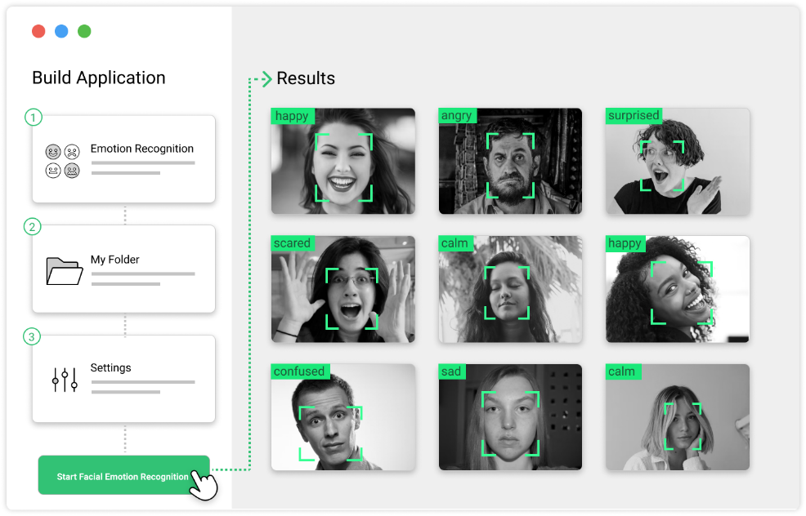
OUTPUT

Slide 15
CONCLUSION
Face emotion recognition technology is a rapidly advancing field that has the potential to revolutionize various industries, including healthcare, entertainment, and marketing. It involves the use of machine learning algorithms to detect and analyze facial expressions in real-time, enabling computers to accurately identify the emotional state of a person.
Although there are concerns regarding the accuracy and ethics of face emotion recognition, ongoing research and development efforts are focused on improving the technology to address these issues.

Slide 16
REFERENCES
1) Bettadapura, V. (2012). Face expression recognition and analysis: the state of the art. arXiv preprint arXiv:1203.6722.
2) Shan, C., Gong, S., & McOwan, P. W. (2005, September). Robust facial expression recognition using local binary patterns. In Image Processing, 2005. ICIP 2005. IEEE International Conference on (Vol. 2, pp. II-370). IEEE.
3) Bhatt, M., Drashti, H., Rathod, M., Kirit, R., Agravat, M., & Shardul, J. (2014). A Studyof Local Binary Pattern Method for Facial Expression Detection. arXiv preprint arXiv:1405.6130.

Slide 17
THANK YOU…

